Slide 1
Firm-Level Corruption in Vietnam
John Rand – University of Copenhagen
Finn Tarp – University of Copenhagen
2012
Anahit Muradian

Slide 2
Corruption in Vietnam - Background
Increased public attention for the fight against corruption in Vietnam after 2005 (new law on corruption passed)
Nevertheless, corrupt behavior widespread in Vietnamese business environment
Costly because of associated efficiency losses in the allocation of resources related to the distorting and uncertain nature of the corruption tax
Investment Climate Assessment Survey (2005) for Vietnam
2/3 of firms incur informal payments
79% expected to give gifts in meetings with tax officials
40% feel it is necessary to pay bribes in order to secure government contracts

Slide 3
Aim and Findings
Better understand the nature, evolution and potential impact of bribe-paying behavior with a view to identifying relevant policy action.
Basic approach: putting together an in-depth description of bribe-paying behavior based on a unique balanced panel data set with information on 1,659 small and medium sized enterprises in 10 provinces of Vietnam in 2005 and 2007
Show that bribe incidence highly associated with firm-level differences in visibility, sunk costs and ability to pay
Decrease in bribe incidence related to behavior changes among firms, and these behavior changes seem to be associated with policy initiatives to improve law enforcement and increased media focus on punitive actions against corruption

Slide 4
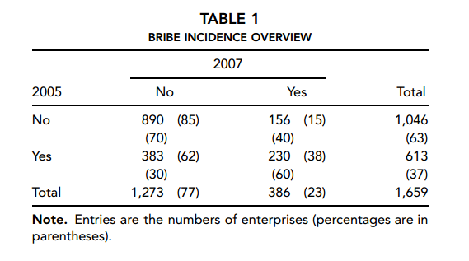
Informal payments (Bribes)
Of 1,659 observations, 37% paid informal payment in 2005, fell to 23% in 2007. 38% of bribe-paying firms paid bribes in both periods. 15% of 1,046 firms that didn’t pay bribes in 2005, did so in 2007.
Underlies that a significant share of firms have at some point found it necessary to pay bribes.

Slide 5
Main purpose for paying bribes:
Get connected to public services (29.9%)
Deal with taxes and tax collectors (21.3%)
Gain government contracts (15.5%)
Other reasons (26.6%)
Get licenses and permits (4.3%)
Deal with customs (2.3%)

Slide 6
Situation:
Firm faces a public official who extracts bribes that need to be paid for the business to run smoothly.
Actions that benefit firm: lax attitude toward implementing rules and regulations
Official may be ready to work the system in favor of the firm
Harmful Actions: stem from discretionary power to harass firm (official has leverage in extracting bribes)
Firms have reduced bargaining power
Corrupt officials = perfect price discriminators (extract highest possible bribe subject to constraints of getting caught and the firm exiting)

Slide 7
List of potential bribe determinants:
Ability or willingness to pay
Firm refusal power
Technology with a low sunk cost component (strengthen firm’s bargaining power)
Exposure/visibility (registered vs not registered) (large vs small)
Degree of interaction with public officials
Legal ownership form (different firms, different legal requirements)
Location
Sector

Slide 8
Promotion of small and medium sized enterprises
Government support for SME’s divided into two groups
Financial assistance: investment incentives
Technical assistance: human resource training, export promotion initiatives and quality and technology programs

Slide 9
Econometric Analysis
Two key issues
The association between potential bribe determinants and probability of providing informal payments
Explain the decrease in bribe incidence between 2005 and 2007

Slide 10
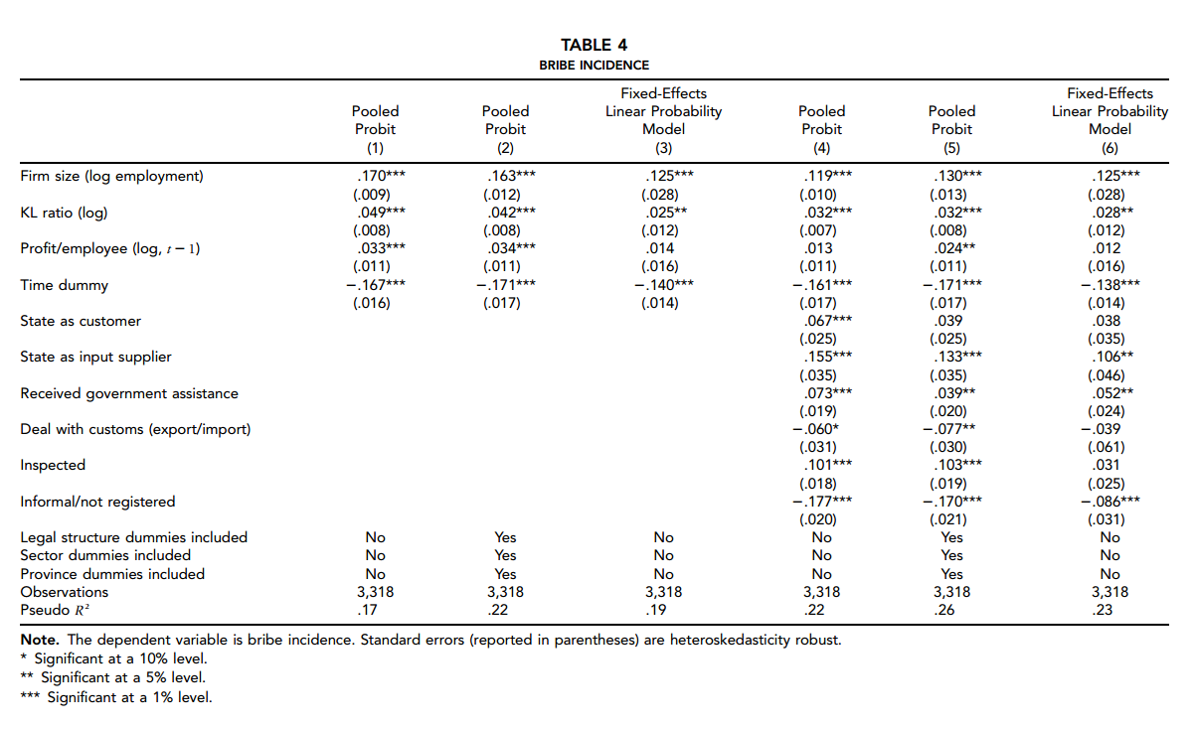

Slide 11
Results
Larger firms more likely to pay bribes (positive and significant in all specifications)…larger firms more visible and exposed to demands from corrupt officials.
Ability to pay (profit per employee) is positive although not well-determined in all specifications
Thus, visible and high profit firms are more likely to pay bribes
Firms that have state as a customer or supplied with inputs by state-owned enterprises more likely to pay bribes
firms inspected by public officials are more likely to pay bribes
Informality negatively correlated with bribes (easier to hide when informal)

Slide 12
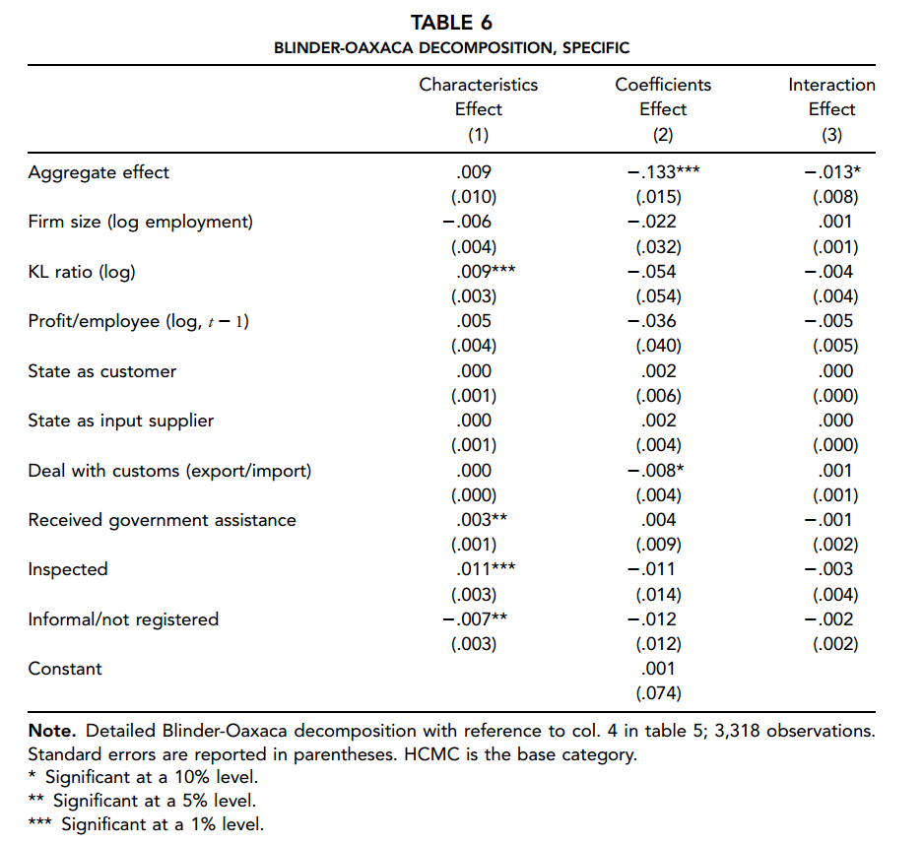

Slide 13
Total differential Blinder-Oaxaca Decomposition
Reports overall effects of characteristics, coefficients and interaction term in explaining the decrease in bribe incidence between 2005 and 2007.
Focus on coefficient effects because 100% of total effect can be explained by changes in behavioral response to characteristics between the two surveys
Of aggregate decrease of 13.3 percentage points, 5.4% explained by sunk-cost component, 2.2% by firm size and 3.6% by profit per employee (ability to pay). Together these three explain more than 80% of the decrease in bribe incidence over time. Implies a relative decline in importance of bribe behavior in these variables.

Slide 14
Thus, recent decline in bribe incidence observed does not reflect changes in firm characteristics. The decrease would’ve occurred even without changes in observable firm characteristics. Entire bribe incidence decrease is explained by coefficient effects, meaning that the decrease in bribe incidence is strictly related to behavior changes among firms and regulators in relation to bribe provision.
Underlying driver: greater political commitment and improved law enforcement post 2005 alongside increased media focus on punitive actions taken against corrupt individuals.

Slide 15
Conclusions
Bribe incidence among SMEs in Vietnam is closely associated with firm-level differences in sunk costs and ability to pay. More visible, relatively large and formally registered firms are more likely to provide informal payments. Thus, ongoing government push to combat bribes is justified.
When state acts as input supplier and provider of government assistance, bribes increase.
Bribe incidence decrease is related to behavioral changes on the part of firms or government regulators associated with ongoing general policy initiatives and increased political commitment to improve law enforcement

